Slide 1
Lending Club Case study
Contributors:
Gowtham Bavireddy
Prakash Danny Sagar

Slide 2
Business Objectives
About the Company:
Largest online loan marketplace.
Offers personal, business, and medical financing loans.
Challenge:
Credit Loss: Financial loss caused by defaults ("Charged-Off" loans).
Lending to risky applicants is the primary source of loss.
Objective of the Study:
Identify risky loan applicants to reduce credit loss
Understand the key drivers of loan defaults.
Outcome
Help improve portfolio and risk assessment strategies

Slide 3
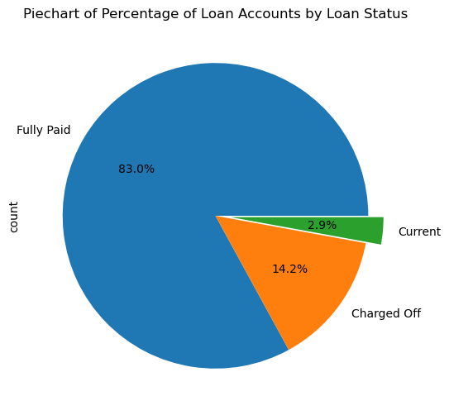
1. Loan Status Distribution
83% Fully Paid:
These applicants have completely repaid their loans, including principal and interest.
Represents the majority of the dataset, indicating overall repayment stability for most borrowers.14.2%
Charged-Off:
These borrowers have defaulted on their loans and stopped paying installments for a prolonged period.
This is the key focus group for risk assessment and default mitigation strategies.2.9%
Current:
These borrowers are still in the process of repaying their loans.
Loan tenure is ongoing, and final repayment status remains undecided.

Slide 4
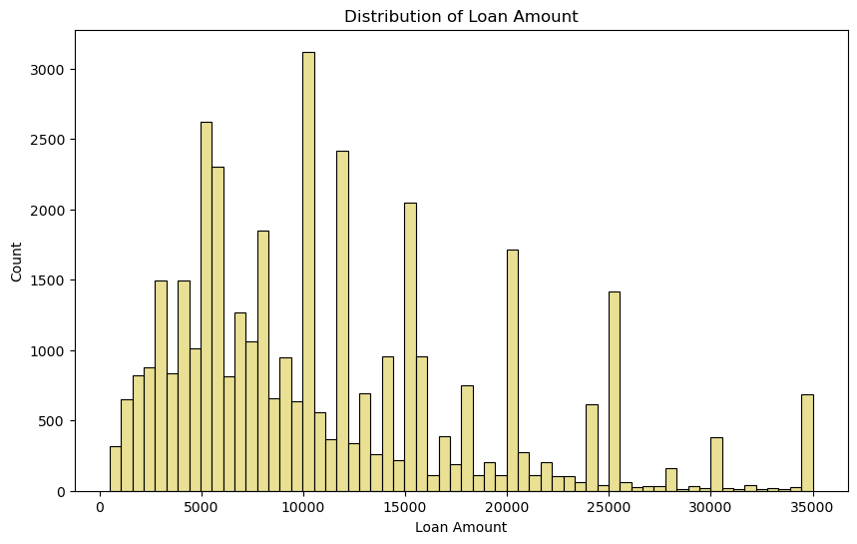
2. Loan Amount Distribution Analysis
Observations:
Loans range from USD 500 to USD 35,000.
The histogram is skewed to the left, indicating that the majority of loans are small-ticket loans.
Peaks are observed at every $5,000 interval, reflecting a general preference for round-figure loan amounts.
Implications:
Small-Ticket Loans dominate, but larger loan amounts show growing significance.
Round Numbers suggest customer preference for easy-to-calculate loan amounts.
Action Points:
Analyze borrower behavior and needs for small-ticket loans versus large-ticket loans.
Review and optimize lending policies for round-figure preferences and high-value loans.
Tailor marketing strategies to meet the demand patterns observed in the distribution

Slide 5
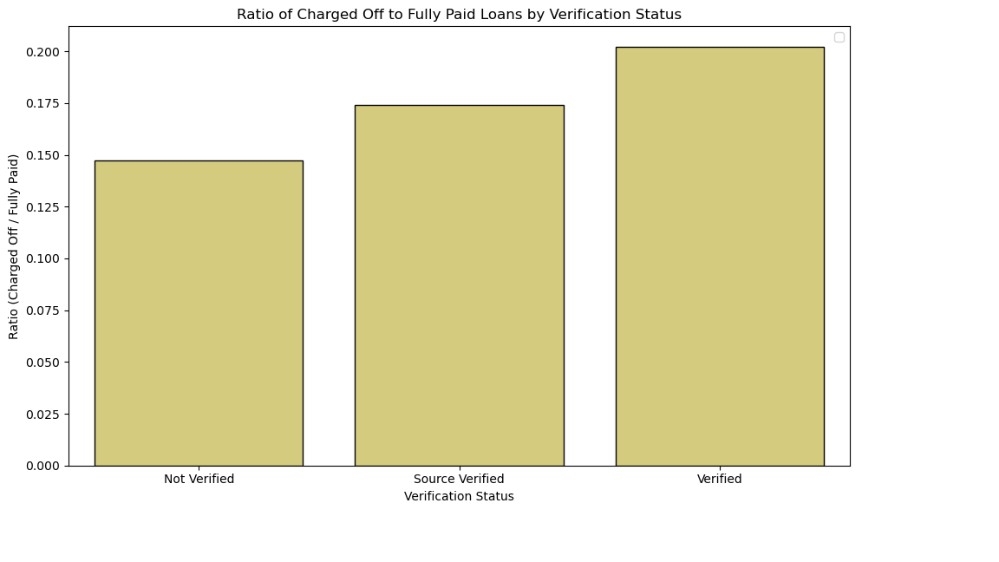
3. Verification Process Improvement Needed
Observation:
Almost 62% of defaulted applications are verified.
Concern:
Highlights gaps in the current verification process.
Action Required:
Strengthen verification criteria and procedures.
Conduct a detailed review to identify weaknesses.
Implement stricter controls and robust checks.
Goal:
Minimize verification errors and enhance application reliability.

Slide 6
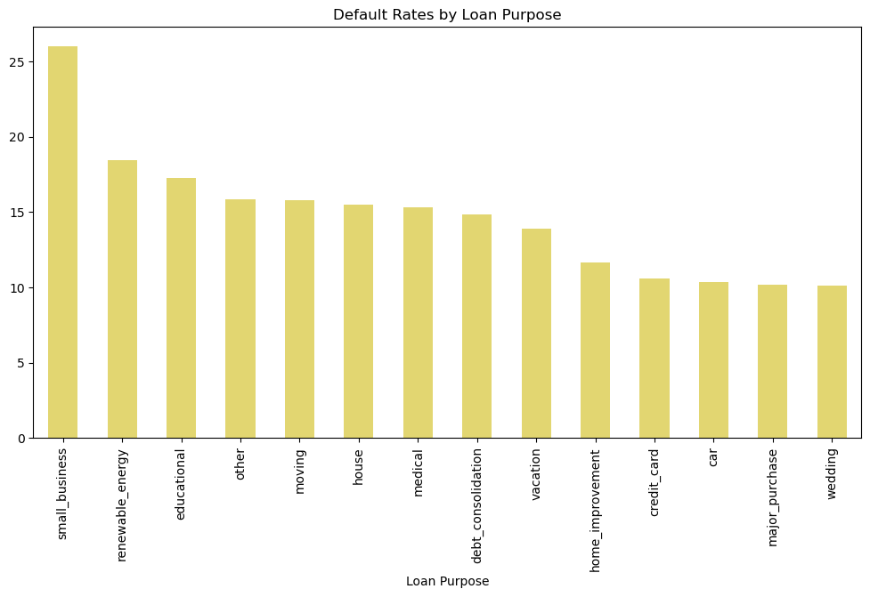
4. Risk Assessment by Loan Purpose
High-Risk Purposes:
Categories such as "Small Business" and "Renewable Energy" exhibit higher default rates.
These categories inherently carry more risk due to external factors and market uncertainties.
Low-Risk Purposes:
Categories like "Weddings" or "Major Purchases" (e.g., buying goods) demonstrate lower default rates
Indicates a more stable repayment behavior, likely tied to personal financial planning
Insights for Strategy:
Focus on stricter evaluation criteria for high-risk categories.
Prioritize promotion or support for low-risk categories to maintain portfolio stability.

Slide 7
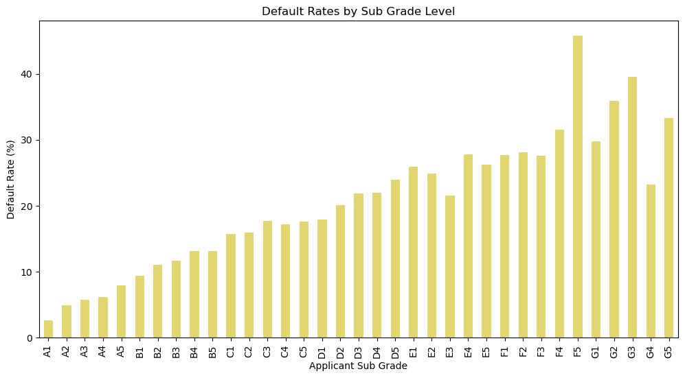
5.1 Grade and Sub-Grade Default Rate Analysis
Key Findings:
"F5" Sub-Grade applicants have the highest default rate.
"G3" and "G2" sub-grades follow closely in terms of default rate.
Implications:
F5 Sub-Grade: Needs urgent attention for stricter risk assessments.
G3 & G2 Sub-Grades: Consider reviewing their risk profiles and mitigating factors to reduce defaults.
Action Points:
Implement targeted strategies to reduce defaults in high-risk sub-grades.
Conduct further analysis to understand the contributing factors for these defaults.

Slide 8
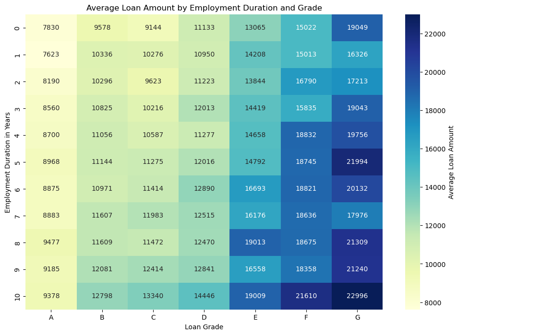
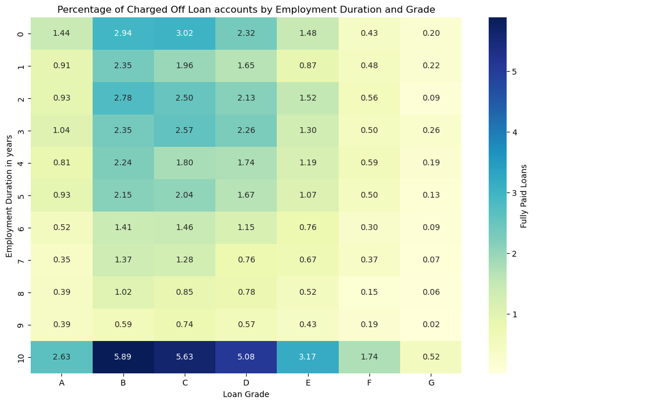
5.2 Grade and Sub-Grade Default Rate Analysis
Key Findings:
Despite the higher risk categories having high ticket loans, the cumulative percentage of portfolio in less
Across all employment duration the portfolio peak is in grade B
The employees with more than 10 years of employment duration have a significantly higher proportion of the overall portfolio
On Further inspection of portfolio spread for fully paid loans and defaulted loans:
Grades A and B had higher concentration of fully paid loans
Grades A,B,C,D had higher concentration and relatively comparable distribution of defaulted loans
Loans in A,B,C,D have lower ticket size and higher concentration of default rate as a percentage of over all portfolio

Slide 9
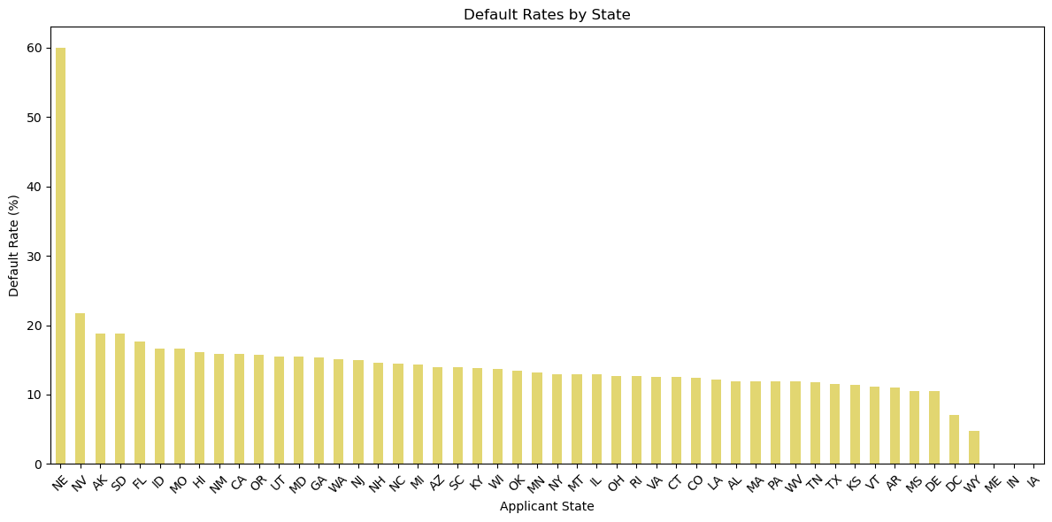
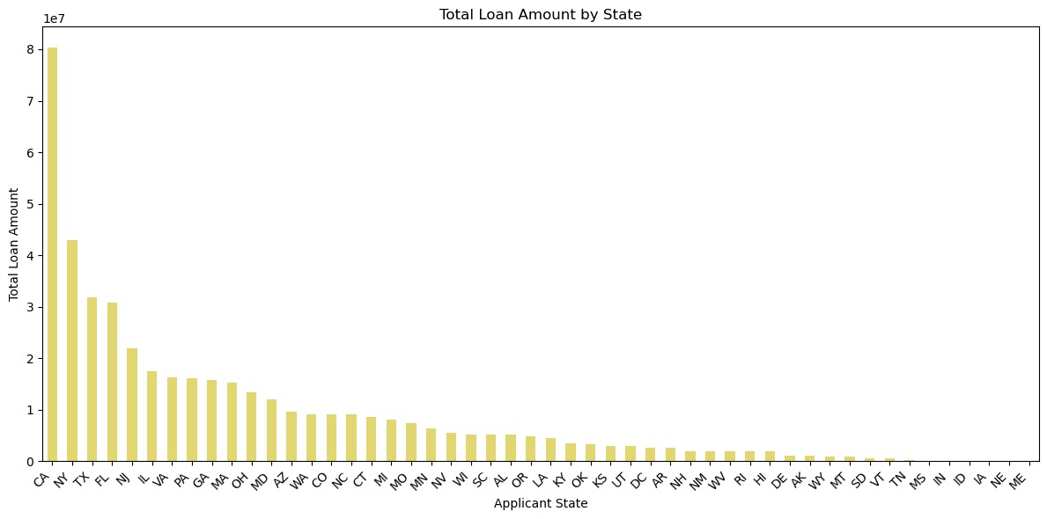
6. Geographic Default Rate Analysis
Key Findings:
NE (Nebraska) state has the highest default rate.
MV (Montana) and AK (Alaska) follow with the next highest default rates.
FL(Florida) and CA(California) are on higher side of default rates of more than 15% - which calls for more stringent risk assessment of applicants in this region.
Implications:
NE State: Requires a focused risk management strategy and targeted interventions.
MV & AK: Further investigation needed to understand regional challenges contributing to higher defaults.
Action Points:
Analyze regional factors affecting default rates in NE, MV, and AK.
Consider adjusting lending strategies or implementing tailored support for these areas.

Slide 10
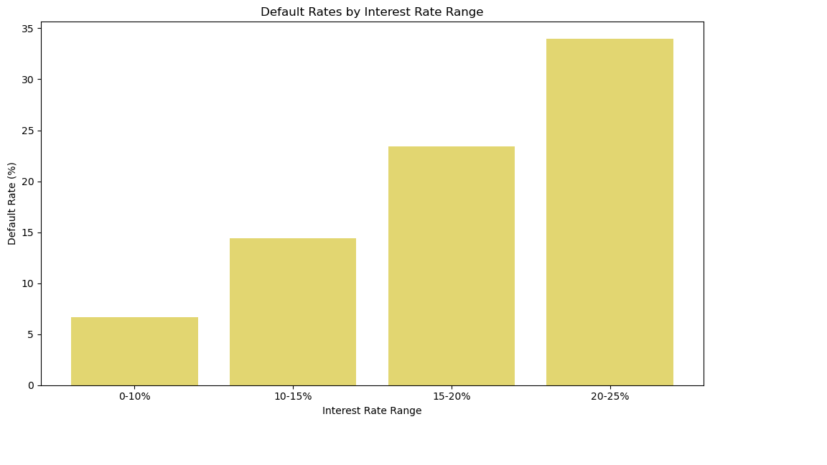
7. Impact of Interest Rate on Loan Default
Key Findings:
Clear Relationship: As the interest rate increases, the default rate also rises significantly.
Key Insight: Borrowers with higher interest rates are more likely to default on their loans.
Implications:
High-interest rates create financial strain, increasing the risk of default.
More vulnerable borrowers tend to be affected by higher interest charges, leading to repayment difficulties.
Action Points:
Reevaluate interest rate structures for higher-risk borrowers.
Consider offering alternative repayment plans or lower interest rates for at-risk groups to reduce defaults.

Slide 11
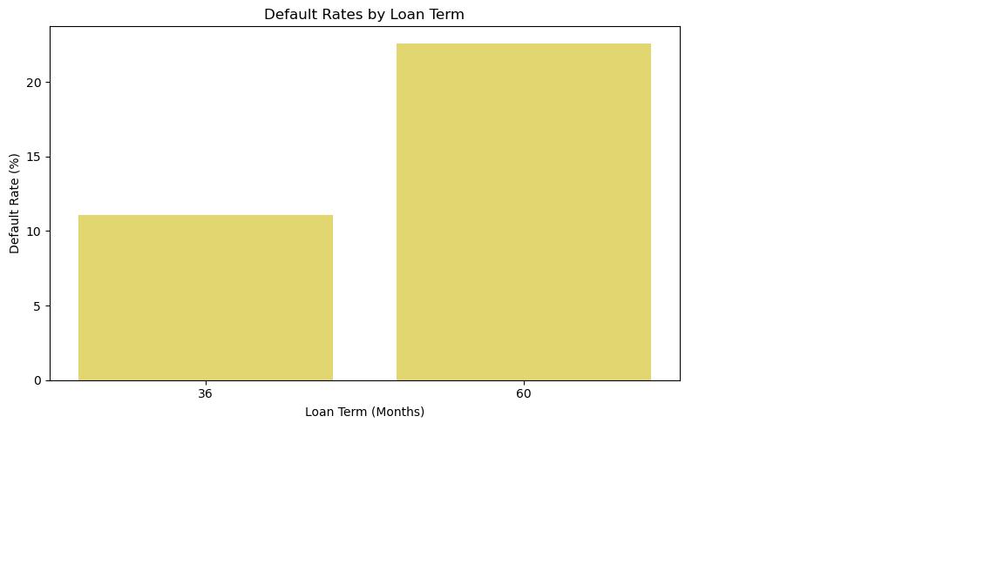

8. Impact of Loan Tenure on Loan Default
Key Findings:
Clear Relationship: Loans with longer tenures (60 months) show higher default rates compared to shorter tenures (36 months).
Key Insight: Borrowers with higher tenures are more likely to default on their loans.
Implications:
Longer loan terms increase the likelihood of repayment challenges, leading to higher defaults.
Borrowers may face difficulties maintaining consistent payments over extended periods, especially with unforeseen life changes.
Action Points:
Review loan tenure options and consider limiting longer-term loans for higher-risk applicants.
Explore offering customized repayment plans or incentives for borrowers with long-tenure loans to reduce default rates.

Slide 12
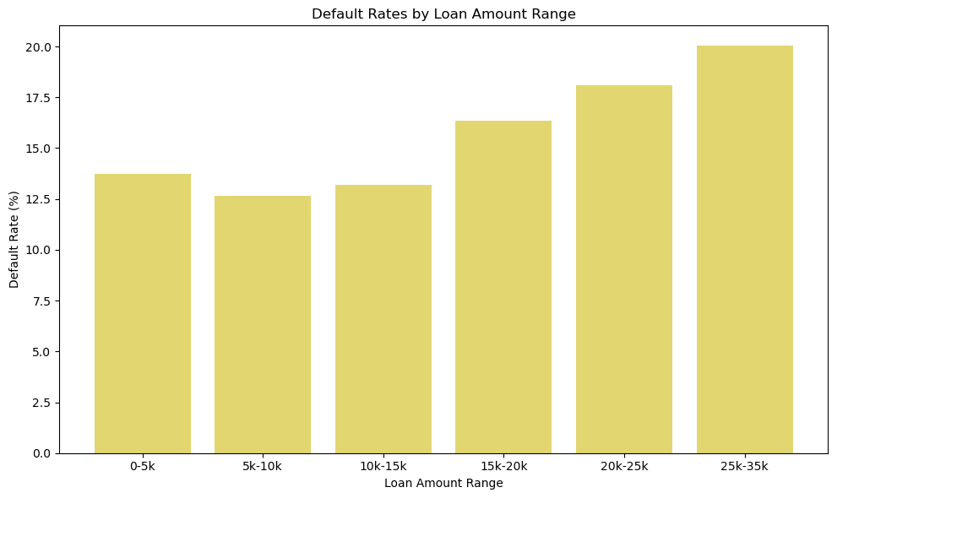
9. Impact of Loan Amount on Loan Default
Key Findings:
Clear Relationship: As the loan amount increases, the default rate also rises.
Key Insight: Higher loan amounts are linked to greater financial risk, making borrowers more likely to default.
Implications:
Larger loans contribute to higher default rates, emphasizing the risk tied to larger borrowings.
Critical Factor: Assessing borrower capacity for higher loan amounts is essential in managing lending risk.
Action Points:
Strengthen assessments of borrower financial capacity before approving higher loan amounts.
Consider offering smaller loan amounts with flexible repayment terms to reduce default risk.

Slide 13
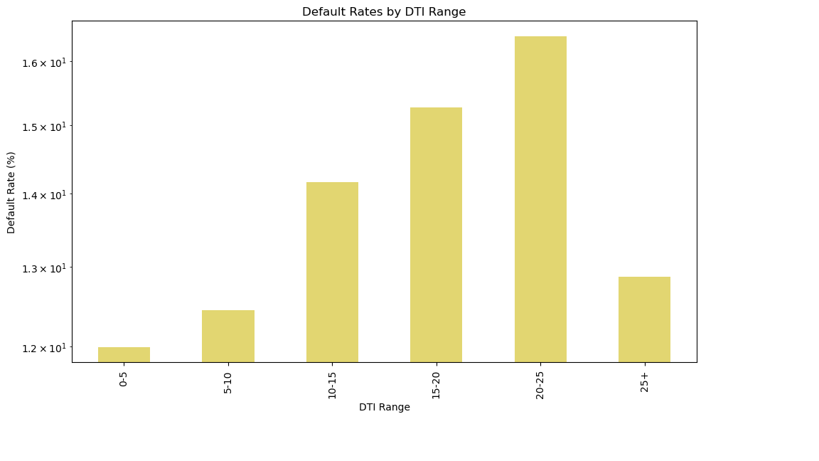
10. Impact of DTI (Debt-to-Income) on Loan Default
Key Findings:
Clear Relationship: As the Debt-to-Income (DTI) ratio increases, the default rate also tends to increase.
Key Insight Borrowers with higher DTI ratios are more likely to default, as they face challenges managing existing debts.
Implications:
A higher DTI ratio suggests a borrower may be over-leveraged and at greater risk of default.
Action Points:
Implement stricter DTI thresholds to reduce lending to high-risk borrowers.
Explore alternative support options for borrowers with higher DTI ratios to mitigate default risks.

Slide 14
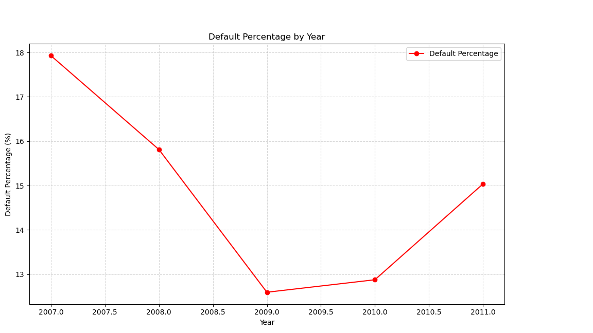
11. Default Percentage Against Issued Loans
Key Findings:
2007 had the highest default rate at 17.93%, likely due to the financial crisis, which caused widespread financial strain and higher loan defaults.
2007: 17.93% (Highest default rate, likely due to the financial crisis)
2008: 15.81%
2009: 12.60%
2010: 12.88%
2011: 15.04%
Implications:
The 2007 financial crisis likely led to a spike in defaults, impacting borrowers’ ability to repay.
Action Points:
2007-2011 Period: Consider revisiting loan approval and risk mitigation strategies during this era to understand and minimize future defaults.
Post-Crisis Monitoring: Increase monitoring of loans issued in volatile periods to better predict and manage default risk.

Slide 15
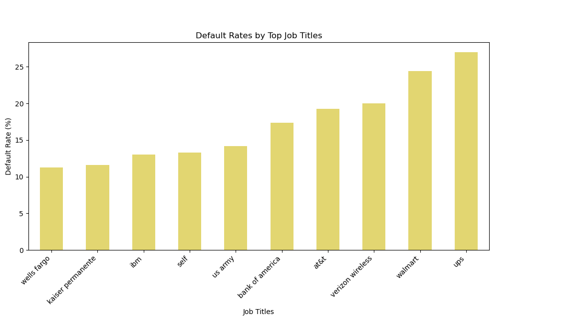
12. Default Rate by Top Job Titles
Key Findings:
"UPS" employees have the highest default rate, followed by those working at "Walmart" and "Verizon Wireless".
Implications:
Certain industries or employers may be associated with higher default rates, potentially due to factors such as income instability or financial stress within these sectors.
Understanding the underlying causes for defaults within these job titles can help improve lending strategies and risk assessment.
Action Points:
Investigate the financial health and employment conditions within these organizations to better assess risk.
Consider adjusting lending criteria or offering tailored repayment options for applicants in high-risk job categories.

Slide 16
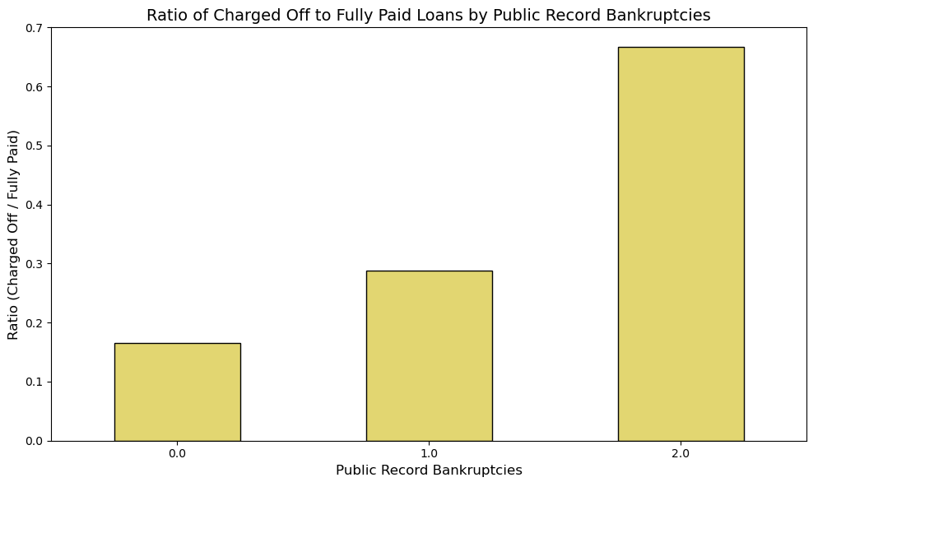
13. Impact of Bankruptcy Records on Loan Default
Key Findings:
The ratio of defaulted accounts to fully paid accounts rises as the number of bankruptcy records increases.
Applicants with any bankruptcy record make up less than 5% of the total portfolio.
Borrowers with a history of bankruptcy are significantly more likely to default on loans, requiring thorough verification
Implications:
Bankruptcy as a Risk Factor: Bankruptcy records are a strong indicator of default risk.
Thorough Review Needed: Applicants with bankruptcy records should undergo enhanced scrutiny during the verification process.
Action Points:
Implement strict evaluation protocols for applicants with bankruptcy history.
Monitor and track the performance of loans issued to such applicants.
Consider adjusting lending limits or interest rates for higher-risk profiles.

Slide 17
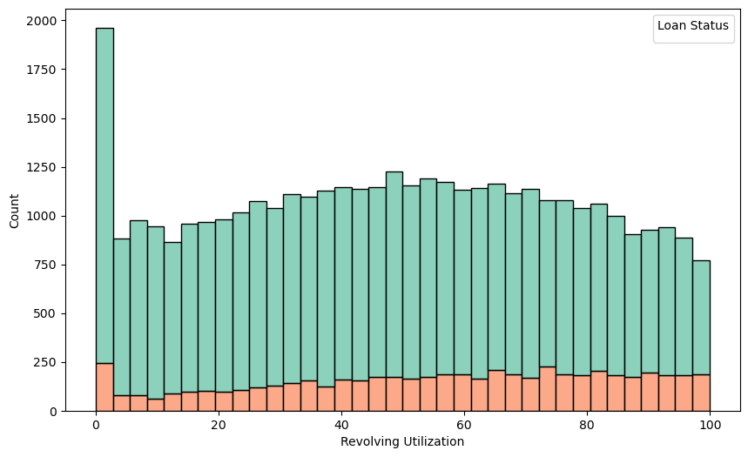
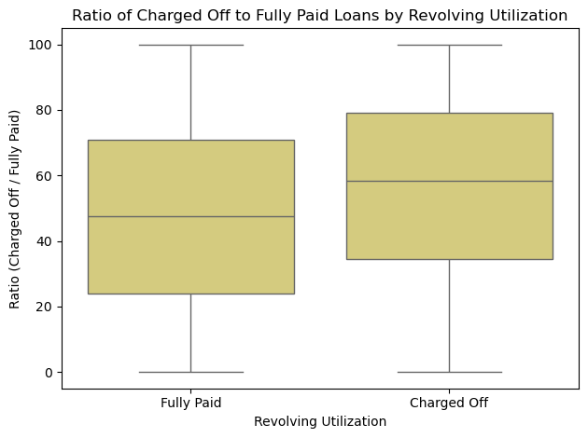
14. Impact of Revolving Utilization Percentage on Loan Default
Key Findings:
Higher Revolving Utilization = Higher Default Risk.
Defaulted Accounts: Average utilization is 60%.
Cleared Accounts: Average utilization is 40%.
Borrowers with higher revolving credit utilization are more likely to default, underscoring the need for proactive measures
Implications:
High Credit Utilization is a critical indicator of financial strain and increased risk of default.
Action Points:
Implement proactive collection mechanisms for accounts with high utilization percentages.
Set thresholds for acceptable credit utilization during the loan approval process.
Offer financial counseling or restructuring options to borrowers with high revolving credit usage.

Slide 18
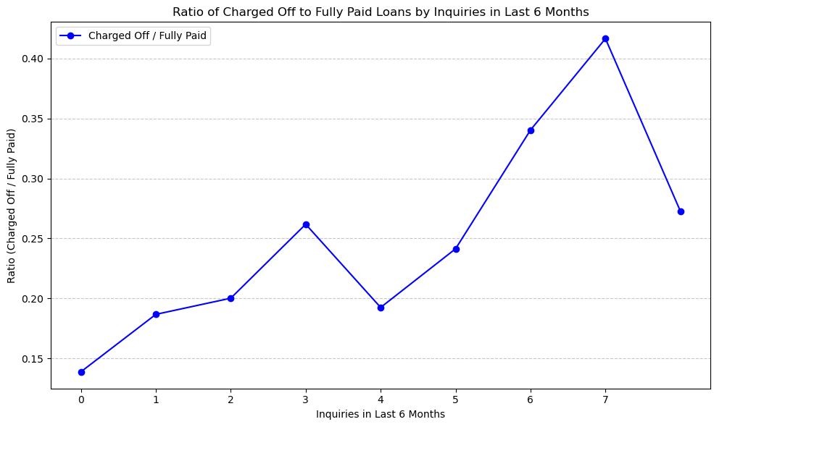
15. Impact of Credit Inquiries on Loan Default
Key Findings:
Higher Credit Inquiries = Higher Default Risk.
Borrowers with multiple credit inquiries are more likely to default, indicating potential financial distress or overleveraging.
Implications:
Frequent credit inquiries may signal riskier financial behavior or dependence on credit, increasing the likelihood of default.
Action Points:
Introduce stricter evaluation criteria for applicants with multiple credit inquiries.
Consider assigning a higher risk score to such applicants during credit assessments.
Provide financial education or support for borrowers with high credit inquiry activity to reduce default.

Slide 19
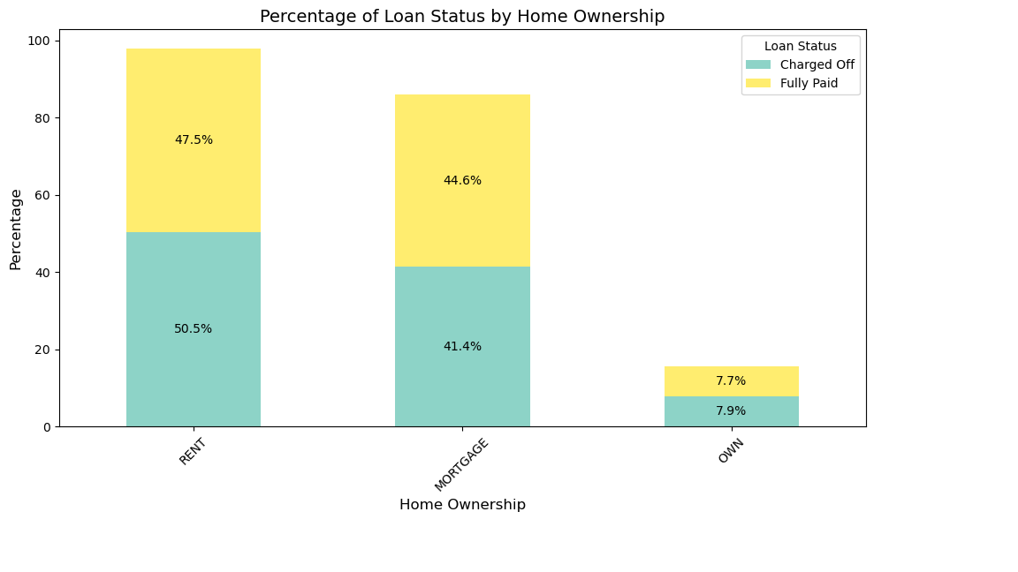
16. Impact of Home Ownership on Loan Default
Key Findings:
A comparison of defaulted users and fully paid users shows no significant difference in the impact of home ownership mode.
Both groups have a comparable split of home ownership modes (e.g., owned, mortgaged, rented).
Implications:
Home ownership mode is not a strong predictor of loan default behavior.
Action Points:
Focus on factors with a stronger correlation to defaults for more effective risk assessment.
Continue monitoring home ownership data for any emerging trends over time.

Slide 20
SUMMARY: Lending Risk Assessment and Portfolio Improvement
Key Findings and Insights
Loan Status and Default Distribution
83% Fully Paid: Most loans are successfully repaid, indicating overall portfolio stability.
14.2% Charged-Off: Defaults are concentrated in a significant minority, warranting focused mitigation strategies.
Small Loans Dominate: Most loans are under $5,000, with larger loans linked to higher default rates.
Verification and Applicant Risk : 62% of Defaulted Applications Verified: Highlights gaps in the verification process.
High-Risk Loan Purposes like "Small Business" and "Renewable Energy" show higher default rates.
Grade and Sub-Grade Risks : F5, G3, and G2 Grades exhibit inconsistent behavior with the grade definition and have highest default rates.
Impact of Financial Metrics on Defaults
Interest Rates: Defaults increase significantly with higher rates.
Loan Tenure: 60-month loans have higher default rates than 36-month loans.
Debt-to-Income Ratio: High DTI correlates strongly with defaults.
Demographic and Behavioral Insights
Bankruptcy Records: Borrowers with such records pose significant default risks despite being a small proportion (5%).
High Revolving Credit Utilization: Indicates financial strain, with defaulted accounts averaging 60% utilization.
Geographic Concentration of Defaults at States with High Default Rates: Nebraska (highest), Montana, Alaska, Florida, and California.
Default Trends Over Time : Defaults peaked at 17.93% in 2007, influenced by the financial crisis, but declined post-2010.
Employment Impact : Certain job titles (e.g., UPS, Walmart) correlate with higher default rates.

Slide 21
SUMMARY: Lending Risk Assessment and Portfolio Improvement
Actions
Strategic Recommendations
Loan Amount: Enhance assessments for higher loan amounts and explore flexible repayment terms.
Verification Status: Strengthen verification criteria to minimize approval of high-risk loans.
Loan Purpose: Enforce stricter evaluation for high-risk purposes and prioritize stable categories such as "Weddings."
Inconsistent Sub Grade behavior: Target F5, G3, and G2 Grades with stricter lending and risk-mitigation strategies.
High Risk States: Tailor risk management to regional challenges and adjust strategies for high-risk states.
Review pricing structures, limit long-term loans for high-risk applicants, and apply stricter DTI thresholds.
Financial health of Borrowers: : Implement robust protocols for applicants with bankruptcy histories and monitor high credit utilization closely.
Employment Impact on Defaults: Investigate employment conditions and tailor strategies for applicants from high-risk sectors.
Strengthen Risk Assessment: Enhance verification processes and focus on high-risk grades and geographic regions.
Tailored Lending Policies: Adjust loan amounts, tenures, and interest rates based on risk profiles.
Data-Driven Interventions: Use insights on DTI, revolving credit utilization, and borrower history to guide decision-making.
Proactive Regional Strategies: Develop specific interventions for states with higher default rates and consider regional economic factors.
Enhanced Borrower Support: Offer financial counseling and customized repayment plans for at-risk borrowers to improve repayment likelihood.

Slide 22
THANK YOU
Gowtham Bavireddy
Prakash Danny Sagar

